Slide 1
PulseOS
Scrum Methodology
©Edgar Moreira
11.05.2025

Slide 2


Introduction
Origin
Developed in 2006 by Spotify to scale Agile without losing startup agility and culture.
Purpose
Balance team autonomy with global strategic alignment.

Slide 3
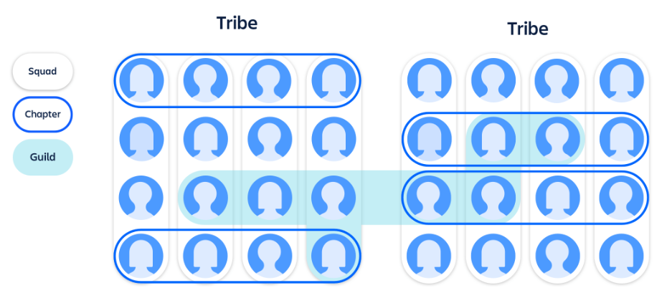
Organizational Structure
Squads (5–10 members)
Cross-functional teams with all necessary skills (Dev, QA, Design, etc.); own a specific mission or product area.
Tribes (20–100 members)
Group of related squads; bi-weekly tribe alignment meeting.
Chapters
Discipline-based groups within a tribe (e.g., Backend, QA); share best practices and technical standards.
Guilds
Company-wide communities of interest (e.g., DevOps, UX); forums for knowledge sharing.

Slide 4
Pillars and Principles
Autonomy
Each squad decides how to achieve its goals.
Alignment
Quarterly OKRs set the overall direction.
Continuous Improvement
Retrospectives, hack days, and experimentation.
Transparency
Visible dashboards with metrics (velocity, lead time).
Suggested image
Infographic of the four pillars.

Slide 5

Ceremonies and Processes
Sprint Planning
2 weeks
Daily Standup
Quick synchronization
Sprint Review
Demo and feedback
Retrospective
Lessons learned and action items

Slide 6

Tools & Metrics
Quarterly OKRs for strategic guidance.
Squad Metrics Velocity, lead time, cycle time.
Visual Dashboards Integrated tools (Azure Devops).
Suggested image Sample metrics dashboard.

Slide 7

Comparison
Scrum vs. Kanban vs. Spotify Model
Roles
Scrum (SM, PO, Dev), Kanban (Flexible), Spotify (Squad, Tribe, Chapter, Guild).
Workflow
Scrum (time-boxed sprints), Kanban (continuous pull), Spotify (sprints + OKRs).
WIP Limits
Scrum (not prescribed), Kanban (mandatory), Spotify (defined by each squad).
Scalability
Scrum (layers of Scrum Masters), Kanban (no built-in scaling), Spotify (designed for large-scale).
Autonomy vs. Alignment
Scrum (lower autonomy focus), Kanban (high autonomy), Spotify (balanced).

Slide 8
Advantages and Disadvantages
Spotify Model Advantages
Organic scalability; innovation culture; high engagement.
Spotify Model Disadvantages
Adoption complexity; requires a mature organizational culture.
Scrum Advantages
Clear structure; ideal for Agile beginners.
Scrum Disadvantages
Can become bureaucratic; scaling requires more Scrum Masters.
Kanban Advantages
Continuous flow; focus on process efficiency.
Kanban Disadvantages
Lack of timeboxing can dilute focus.

Slide 9
My suggestion to start
Context
Tribe with separate Backend and Frontend squads.
Goal
Leverage Spotify Model to enhance autonomy, alignment and collaboration.

Slide 10
Tribe Configuration
Single Tribe encompassing both Backend and Frontend squads
Bi-weekly Tribe Alignment: roadmap, OKRs, and cross-squad dependencies.

Slide 11
Squad Structure
Feature-Oriented Squads Backend + Frontend + QA + Scrum Master + Tech Lead for each Initiative.
End-to-End Ownership
Each squad delivers complete feature sets.

Slide 12
Chapters
Backend Chapter
All backend devs + Backend TL; focus on architecture and standards.
Frontend Chapter
All frontend devs + Frontend TL; focus on UI frameworks and tests.
Chapter Leads
Ensure best practices and technical consistency.
1
2
3

Slide 13
Guilds
DevOps Guild
CI/CD, deployment practices across squads.
Quality Automation Guild
testing frameworks and automation strategies.
Open to members across the organization for knowledge sharing.

Slide 14
Ceremonies & Workflows
Sprint Planning & Review at the Tribe level for end-to-end visibility.
Daily Standups at squad level with cross-squad highlights in a shared channel.
Tribe Retrospectives for inter-squad improvements.

Slide 15

And Azure Devops …
Teams & Area Paths
Create two teams: Backend Team and Frontend Team.
Define Area Paths: Tribe/Product/Backend and Tribe/Product/Frontend.
Iteration Paths
Set up sprint iterations under Tribe/Product/Sprints/Sprint 1, etc., shared by both teams.
Boards
Each team has its own Kanban board and backlog view filtered by Area Path.
Use Features and Epics at project level for product-wide planning.
Repositories
Separate Git repos for Backend and Frontend code.
Implement branch policies (PR reviews, build validation) per repo.
Pipelines
Define CI pipelines for build and unit tests in each repo.
CD release pipelines deploying to dev, staging, and production.
Test Plans
QA creates Test Suites and Test Cases under each team’s Area Path.
Link test cases to user stories for traceability.
Dashboards & Reporting
Team-level dashboards: Sprint burndown, work item charts, pipeline status.
Tribe-level dashboard: Cross-team metrics, OKR progress, deployment health.

Slide 16
PulseOS
Scrum Methodology
Thank you!
©Edgar Moreira
11.05.2025

